Slide 1
Differential Privacy
Notes:
Budget
Explain DP (example)

Slide 2
Absolute Disclosure Prevention is Impossible
Netflix Prize dataset:
  Netflix released a dataset containing 100,480,507 movie ratings and their dates created by 480,189 Netflix subscribers.
  Privacy leak: in this dataset, not two records are similar more than 50%

Slide 3
Absolute Disclosure Prevention is Impossible
Age | Eye Color | Lung cancer | Sex
20 | Brown | N | M
25 | Brown | N | F
38 | Blue | Y | M
45 | Green | Y | M
31 | Blue | N | F
52 | Brown | N | M
Lung cancer data D of a hospital.
Query:
How many people with green eyes have lung cancer? 1

Slide 4
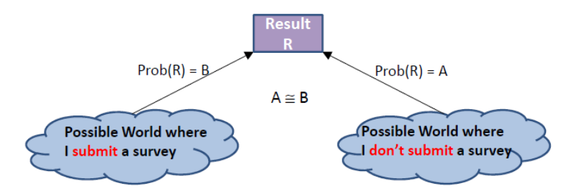
Differential Privacy

Slide 5
Differential Privacy
Age | Eye Color | Lung cancer | Sex
20 | Brown | N | M
25 | Brown | N | F
38 | Blue | Y | M
45 | Green | Y | M
31 | Blue | N | F
52 | Brown | N | M
Query:
How many people with green eyes have lung cancer?

Slide 6
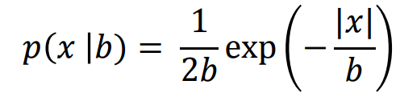
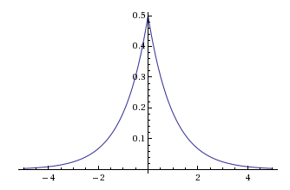
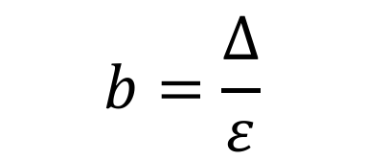
The Laplace Mechanism
Add noise to the true answer: 1
$$b=\frac{Δ}{ε}$$

Slide 7
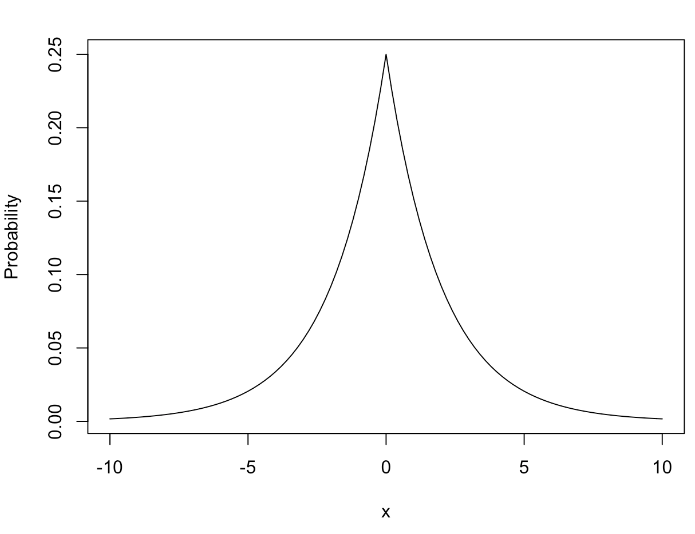
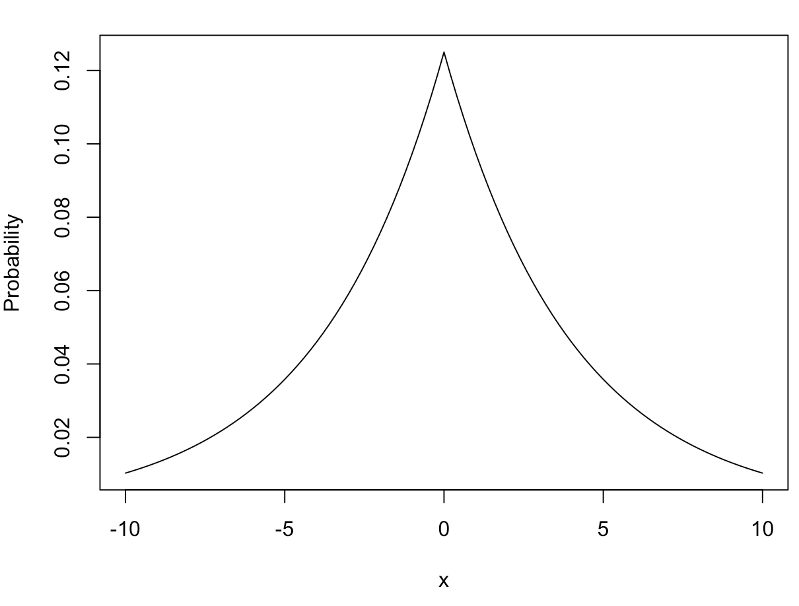



The Laplace Mechanism
Lap($\frac{Δ}{ε}$) ~
$ε$ is the level of privacy, the smaller, the higher the privacy is preserved. But less utility (larger uncertainty)
$ε$ = 0.5
$ε$ = 0.25

Slide 8
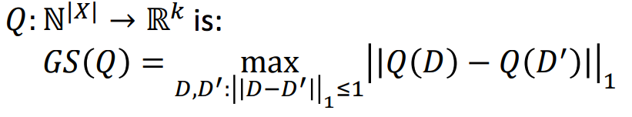
The Laplace Mechanism
Lap($\frac{Δ}{ε}$) ~
$∆=$ is the sensitivity of a query, the smaller, the better
Age | Eye Color | Lung cancer | Sex
20 | Brown | N | M
25 | Brown | N | F
38 | Blue | Y | M
45 | Green | Y | M
31 | Blue | N | F
52 | Brown | N | M
Count query:
How many people have brown eyes? Sensitivity 1
How many have brown eyes, how many have blue eyes, how many have green eyes? Sensitivity 1
How many people have brown eyes and how many have lung cancer? Sensitivity 1
How many people with green eyes have lung cancer? Sensitivity 1
Other query:
The total ages. Sensitivity 52
The total ages of people with green eyes. Sensitivity 52

Slide 9
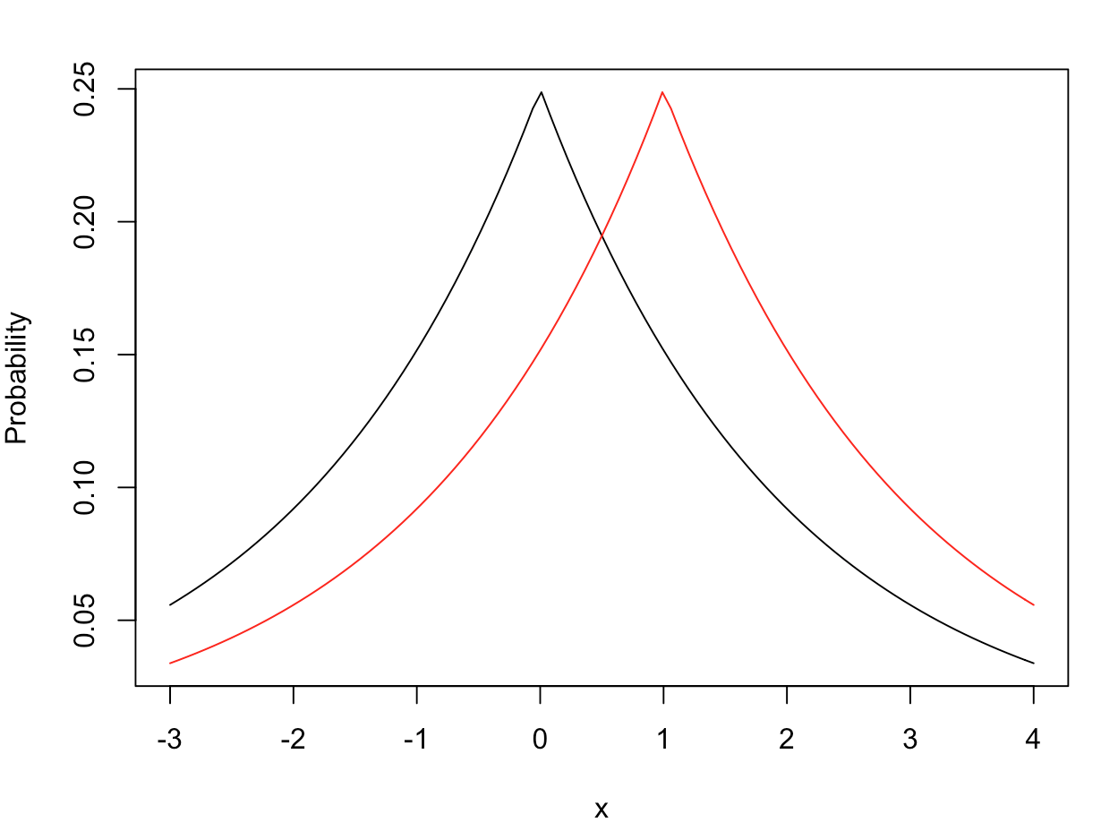





The Laplace Mechanism
Query:
How many people with green eyes have lung cancer?
D(+1): dataset with green eyes
D(-1): dataset without green eyes
Can achieve $ε$-differential privacy. Why?
The largest difference between two p.d.f (the purple lines) is always bounded, for instance:
$$P_{D(+1)}$$
$$P_{D(−1)}$$
$$\frac{P_{D\left(+1\right)}\left(x=0\right)}{P_{D\left(−1\right)}\left(x=0\right)}∈\left(ε,\frac{1}{ε}\right)$$
$\frac{0.15}{0.25}=0.6∈(0.5, 2)$
$ε$ = 0.5 $∆=1$

Slide 10
The Exponential Mechanism
Age | Eye Color | Lung cancer | Sex
20 | Brown | N | M
25 | Brown | N | F
38 | Blue | Y | M
45 | Green | Y | M
31 | Blue | N | F
52 | Brown | N | M
What about non-numerical query?
What’s the most common eye color in this company?

Slide 11
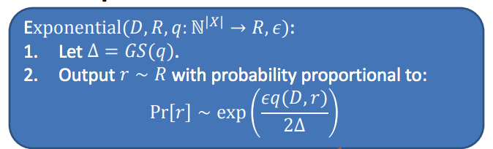
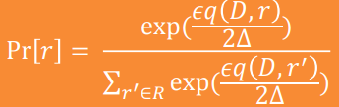
The Exponential Mechanism
q(D, r) is the quality score
A larger q(D, r) means the higher chance r will be answered.

Slide 12

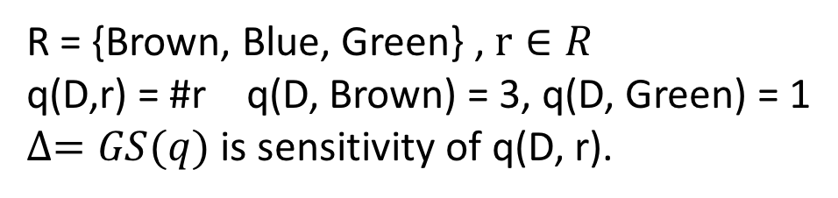
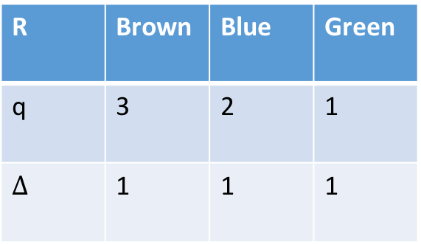
The Exponential Mechanism
Age | Eye Color | Lung cancer | Sex
20 | Brown | N | M
25 | Brown | N | F
38 | Blue | Y | M
45 | Green | Y | M
31 | Blue | N | F
52 | Brown | N | M
What’s the most common eye color in this company?
R | Brown | Blue | Green
q | 3 | 2 | 1
$∆$ | 1 | 1 | 1
R = {Brown, Blue, Green} , $r∈R$
q(D,r) = #r q(D, Brown) = 3, q(D, Green) = 1
$∆=GS(q)$ is sensitivity of q(D, r).

Slide 13
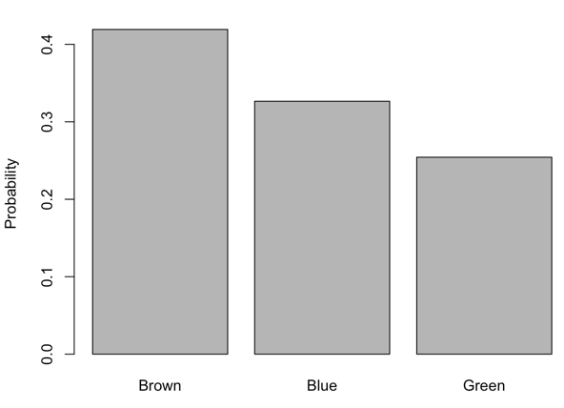
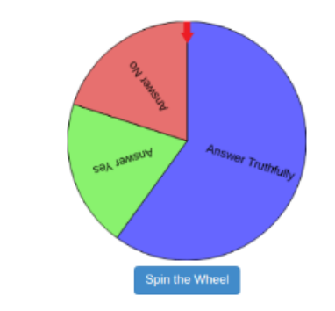

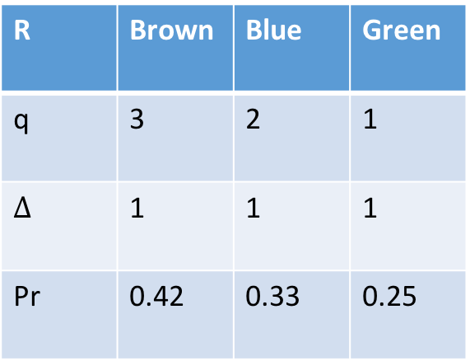
The Exponential Mechanism
For $ε=0.5$
R | Brown | Blue | Green
q | 3 | 2 | 1
$∆$ | 1 | 1 | 1
Pr | 0.42 | 0.33 | 0.25

Slide 14
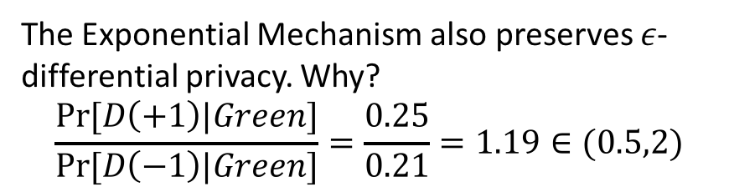
The Exponential Mechanism
For $ε=0.5$
R | Brown | Blue | Green
q | 3 | 2 | 1
$∆$ | 1 | 1 | 1
Pr | 0.42 | 0.33 | 0.25
0
0.44
0.35
0.21
The Exponential Mechanism also preserves 𝜖-differential privacy. Why?
$$\frac{Pr⁡[D\left(+1\right)|Green]}{Pr⁡[D\left(−1\right)|Green]}=\frac{0.25}{0.21}=1.19∈(0.5,2)$$

Slide 15
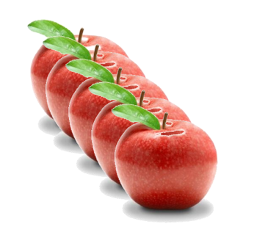
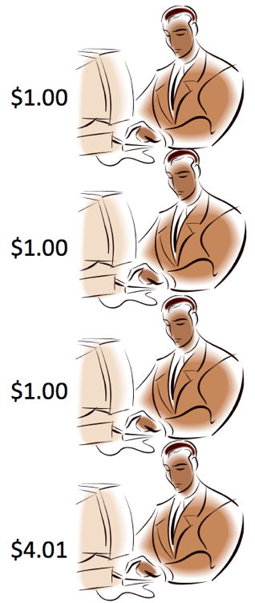
The Exponential Mechanism
How much should I sale the apple?
Bidding
Set price at $1
Four people will buy
$1
$1
$1
$1
profit
$4
$1*4 people

Slide 16
The Exponential Mechanism
How much should I sale the apple?
Bidding
Set price at $1.01
One
$1.01
profit
$1.01
$1.01*1

Slide 17
The Exponential Mechanism
How much should I sale the apple?
Bidding
Set price at $4.01
$4.01
profit
$4.01

Slide 18
The Exponential Mechanism
How much should I sale the apple?
Bidding
Set price at $4.02
profit
$0

Slide 19






The Exponential Mechanism
How much should I sale the apple?
Dataset (D)
R = {$0.10, $0.11, $0.12, …, $1.00, $1.01, …, $4.99, $5.00} $r∈R$
Set price at $ $r$
…
$$\#(d_{i}>r)$$
$$r$
$$r$
profit
$$q\left(D,r\right)=r∗\#(d_{i}>r)$$
$4

Slide 20
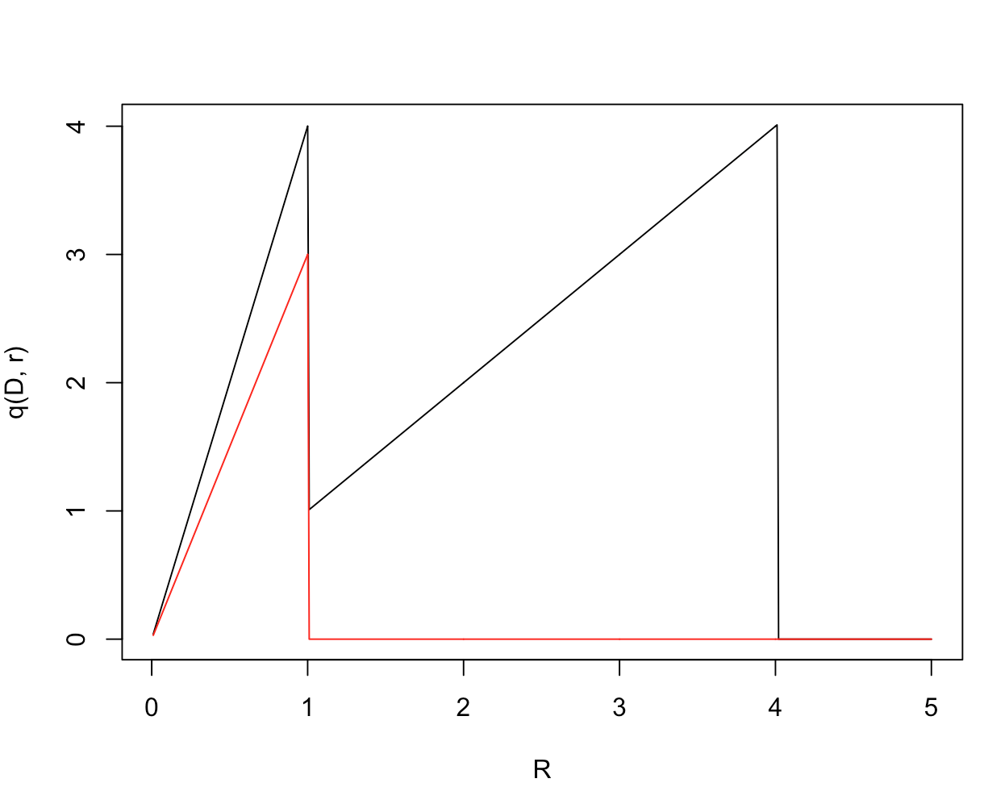


The Exponential Mechanism
R = {$0.01, $0.11, $0.12, …, $1.00, $1.01, …, $4.99, $5.00} $r∈R$
$$q\left(D,r\right)=r∗\#(d_{i}>=r)$$
D’
D
$$∆=GS\left(q\right)=4.01$$

Slide 21
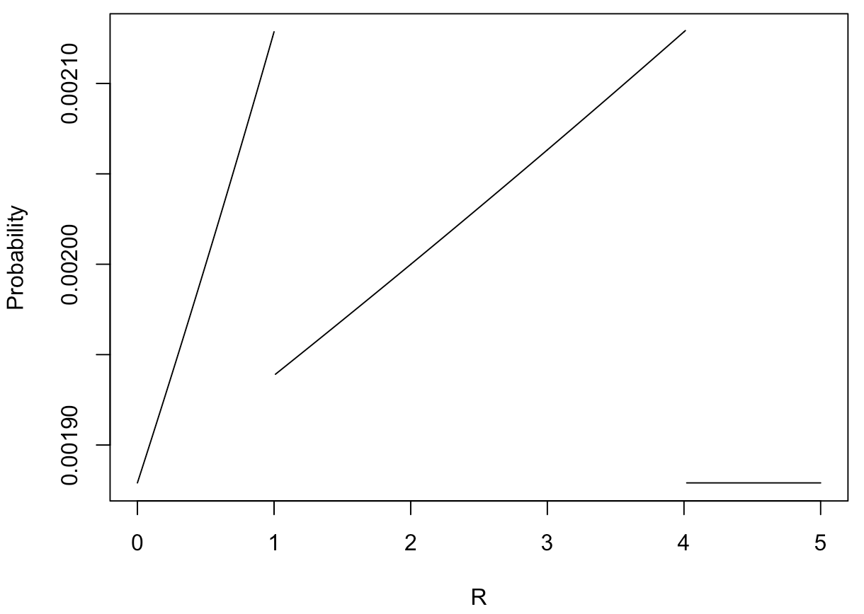
The Exponential Mechanism

Slide 22
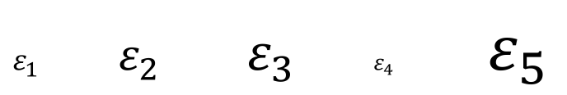
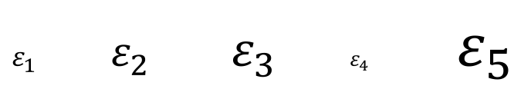
Composition Theorems
Sequential composition:
$ε_{1}$ $ε_{2}$ $ε_{3}$ $ε_{4}$ $ε_{5}$
Parallel composition:
$ε_{1}$ $ε_{2}$ $ε_{3}$ $ε_{4}$ $ε_{5}$

